Slide 1
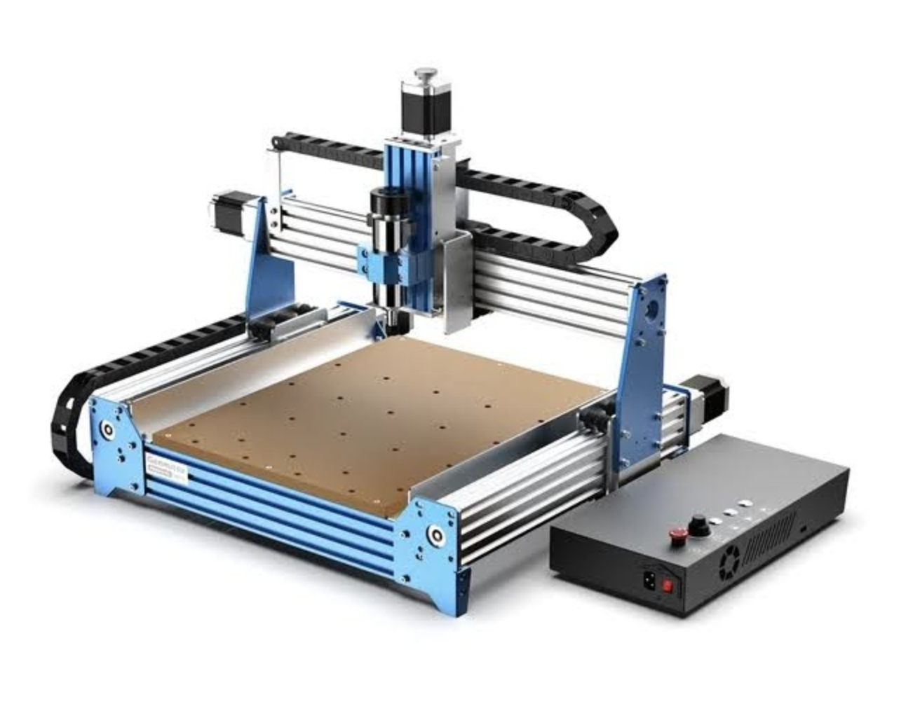
CNC Routing – From a hobby perspective
gwest@redhat.com

Slide 2
CNC – WHAT IS IT?
CNC -Computer numerical control is a method for automating control of machine tools through the use of software embedded in a microcomputer attached to the tool. It is commonly used in manufacturing for machining metal and plastic parts.
Types of CNC:
CNC Milling Machine
CNC Lathe
CNC Router
CNC Laser Cutter
CNC Plasma Cutter
3d Printer

Slide 3
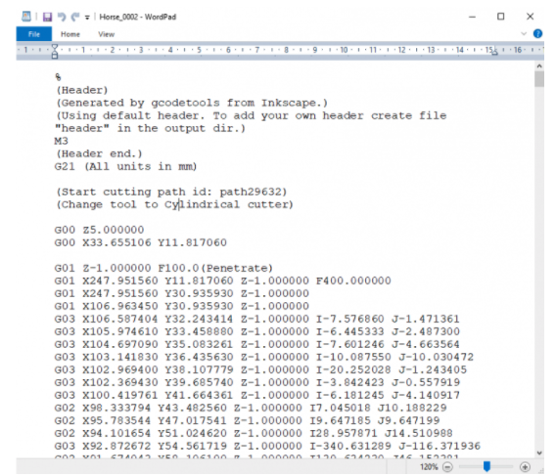
G-CODE – The machine code
A simple text file, with movement commands (G0X) and machine control commands
While its common for machinist to write G-Code directly, most users use CAM tools to generate G-Code directly from drawings.

Slide 4
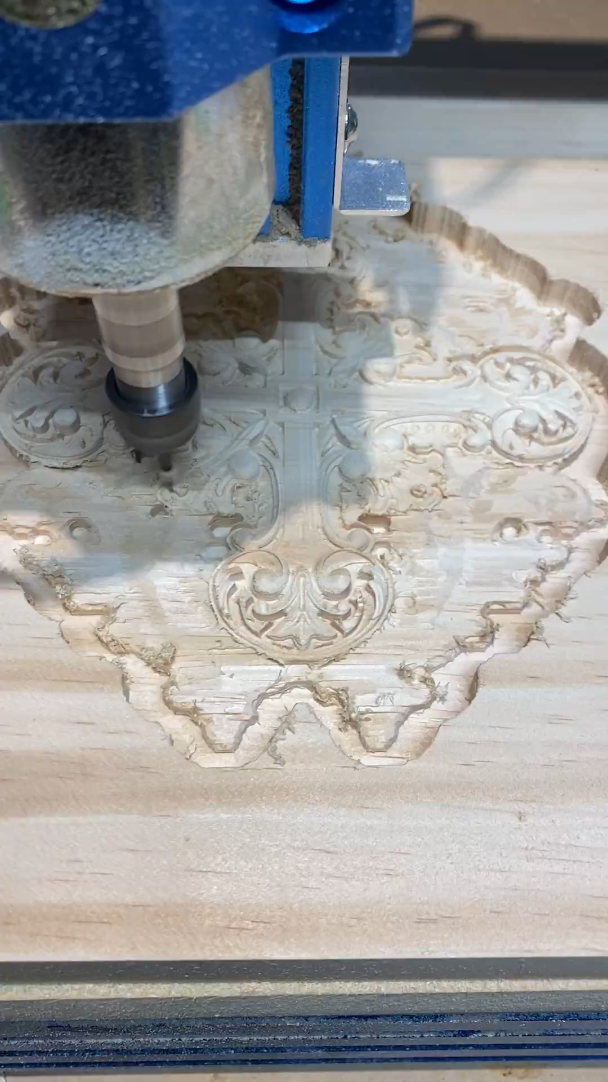
CNC Router In Action
CNC Consists of 3 axis:
X Axis
Y Axis
Z Axis
For a router, a spindle drives a cutting tool

Slide 5
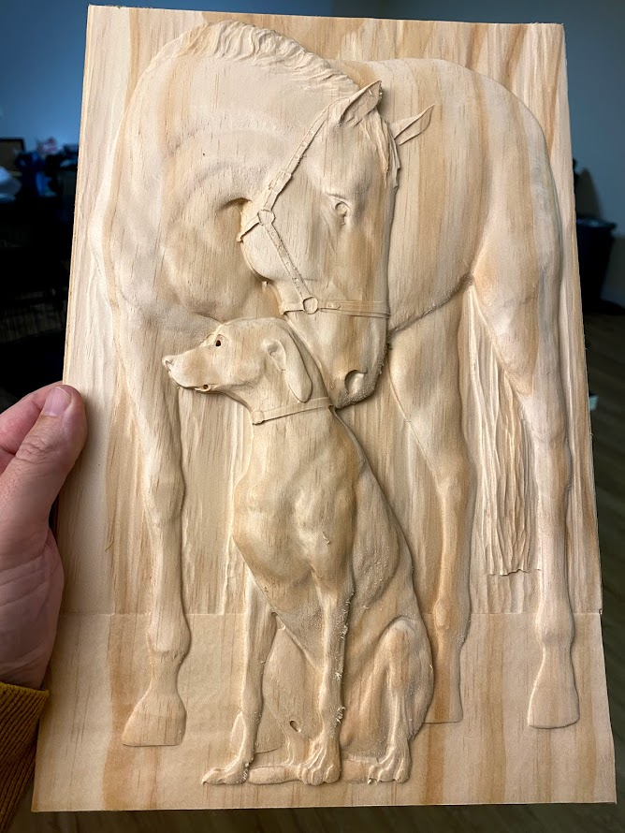
So what can you do with it?
3d Wood Carving
Wood Joinery for Furniture
Parts for CNC
Arts and Crafts

Slide 6
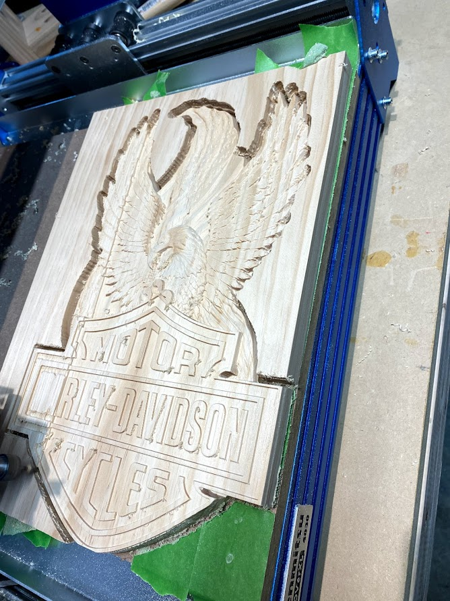
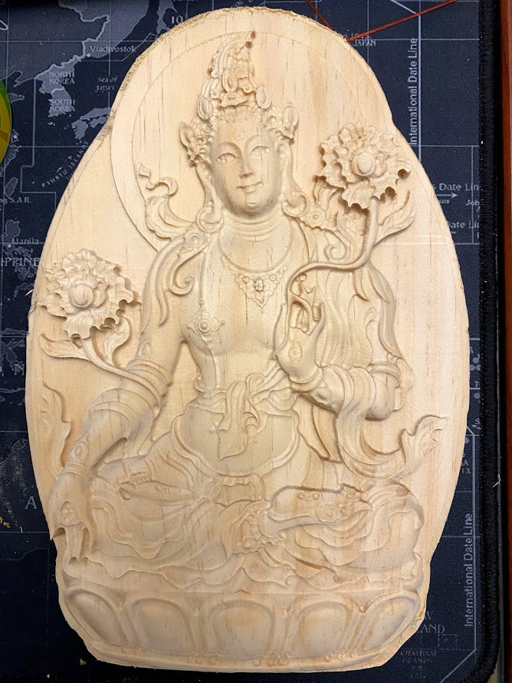
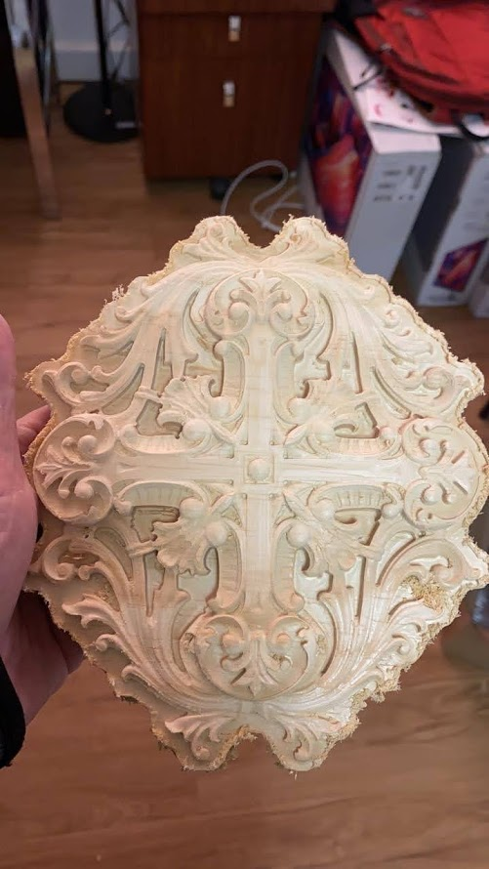
Examples of my carvins

Slide 7
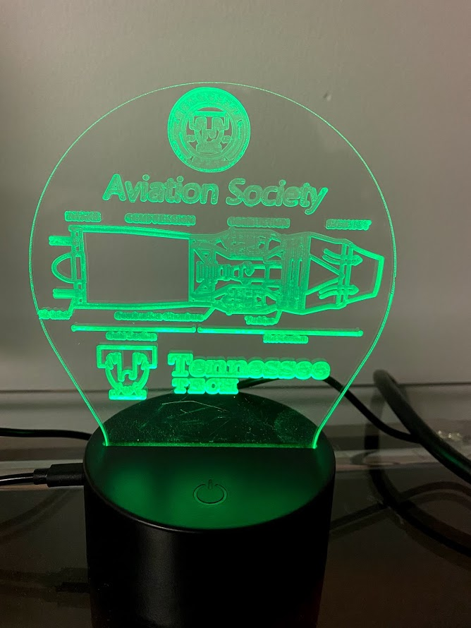
Edge Lit Acrylic Signs
First Attempt
SVG Based Vectored ART
Using either a V-Bit or a Diamond Drag Bit

Slide 8
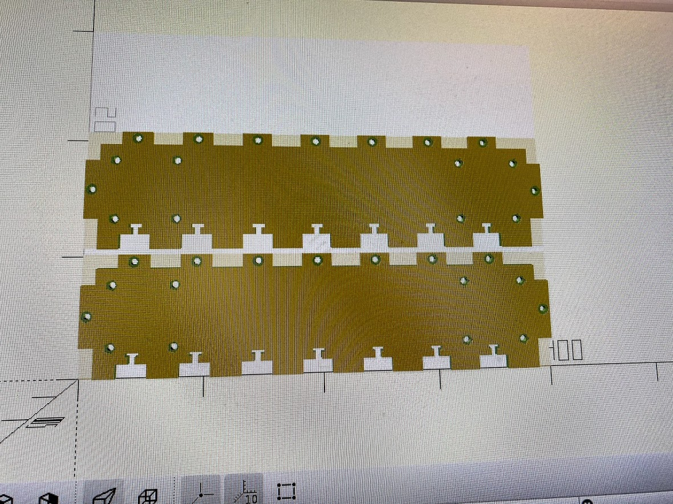
Furniture Components
Designed to be interlocking components for furninture or workbenchs.

Slide 9
Tools in my kit bag
ESTLCAM – Takes 2d or 3d and Generates G-CODE
OPENSCAD – Language for design of 3d/2.5d artwork
CANDLE – Software that sends the gcode to the cnc
GRBL – The firmware on the CNC that takes G-CODE and drives the motors

Slide 10
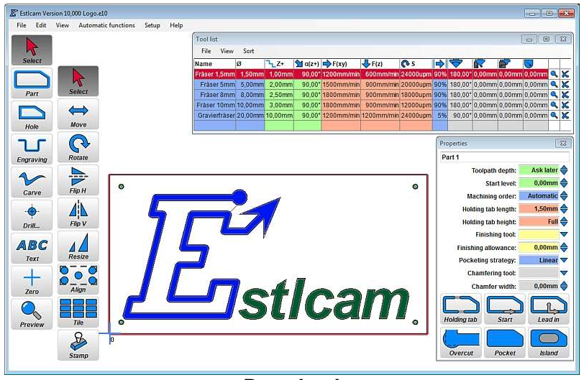
ESTLCAM
Takes svg/dwg and stl files and converts to gcode.
STLs can generate roughing pass gcode, finish pass gcode, and a cutout gcode
2.5D using svg or autocad file for very rapid creation of industrial parts
By using multiple files, a complex 3d part can be created by combining operations

Slide 11
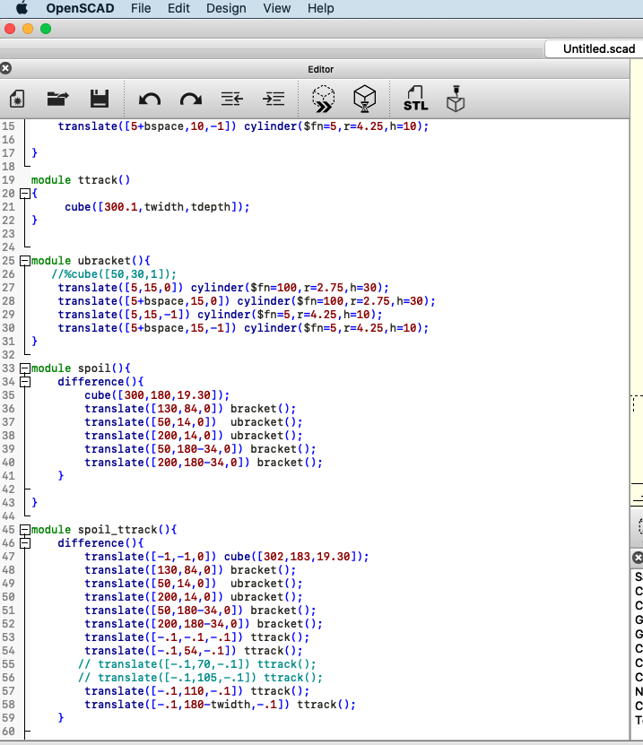
OpenScad
Easy design of 3d objects using a programming/scripting language specifically designed for creation of physical objects.
Works well with a 2.5D design workflow to do quick mechanical parts
Create overall object
Create slices and save as svg for each slice
Load slice into estlcam and generate operations for that slice
Repeate

